Slide 1
Top 5 Trends in Database Technology
Session ID#: 995
Guy Harrison,
Executive Director, Information Mgt R&D,
Dell Software Group
@guyharrison

Slide 2
Top 5 Trends in Database Technology
Guy Harrison,
Executive Director, Information Mgt R&D,
Dell Software Group

Slide 3
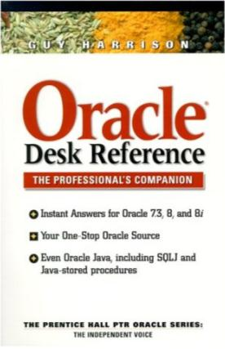
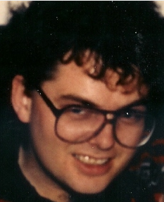
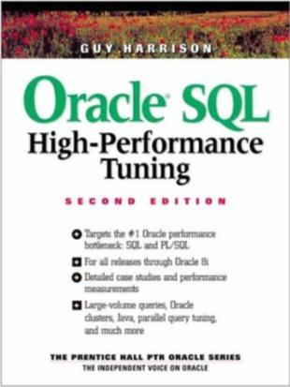
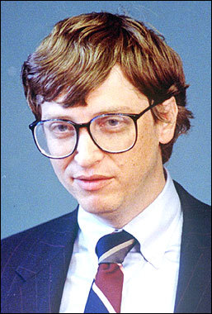
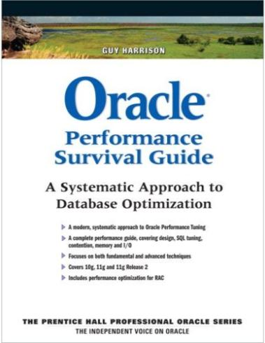

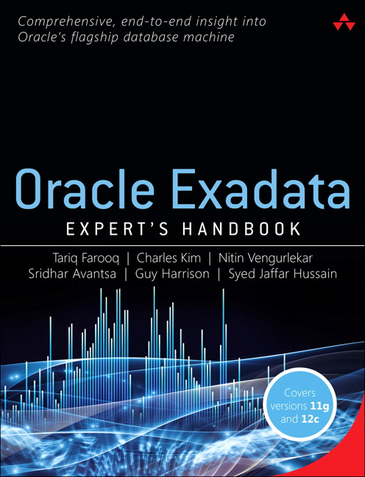
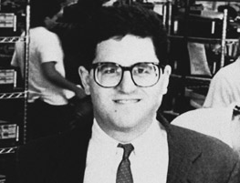
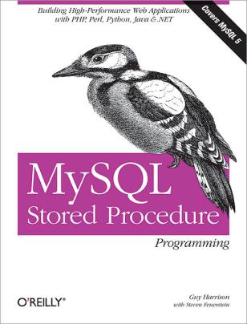



Introductions
Web: guyharrison.net
Email: guy.harrison@software.dell.com
Twitter: @guyharrison

Slide 4
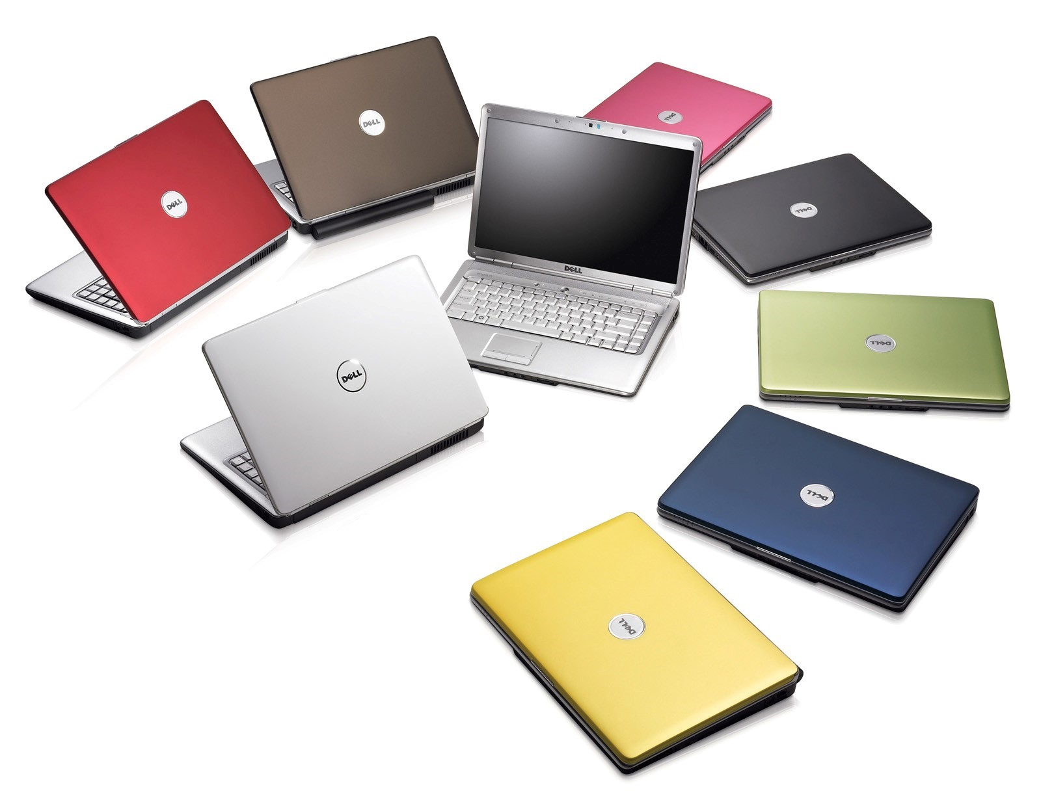

Slide 5
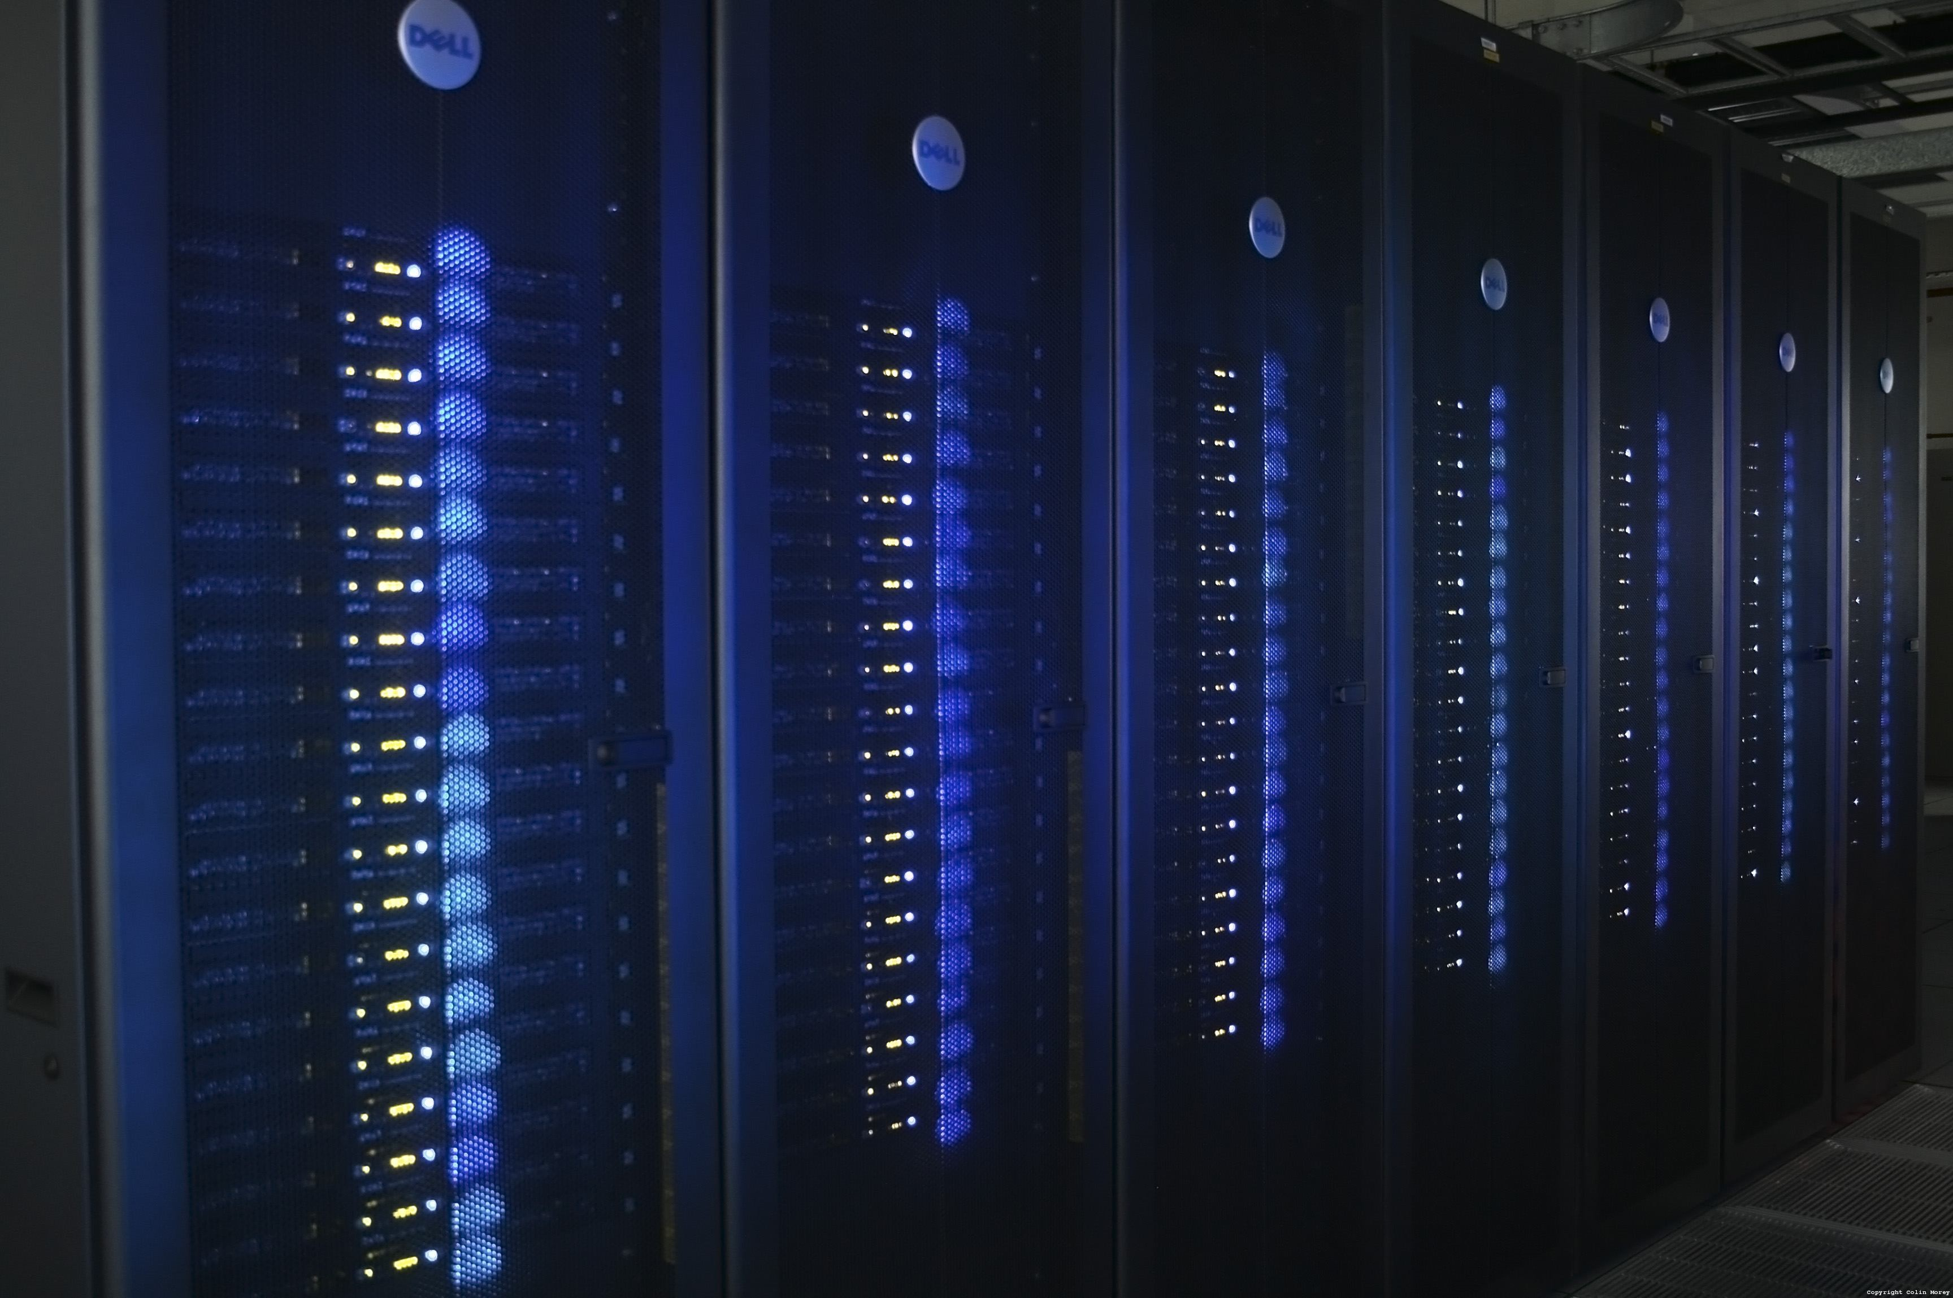

Slide 6
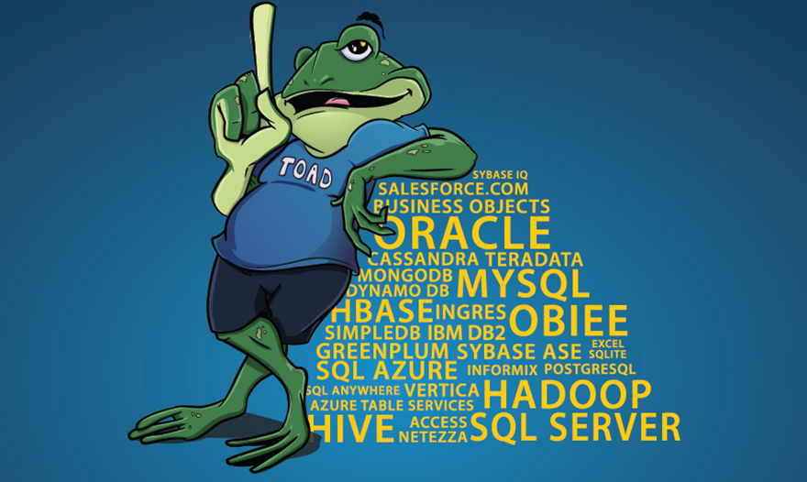

Slide 7




Dell and Quest – a brief history

Slide 8

But Seriously

Slide 9
5 Database Technology Trends
The end of “one size fits all”
Big Data and Hadoop
NoSQL
Columnar architectures
The end of disk?

Slide 10
Trend #1: The end of “one size fits all”

Slide 11
History of databases
Magnetic tape
“flat” (sequential) files
IDMS
ADABAS
Access
HBase
Pre-computer technologies:
Printing press Dewey decimal system Punched cards
Magnetic Disk
System R
Postgres
Dynamo
Oracle V2
MySQL
MongoDB
Redis
VoltDB
Neo4J
1940-50
1950-60
1960-70
1970-80
1980-90
1990-2000
2000-2010
SQL Server
Aerospike
Relational Model defined
Sybase
Hana
Informix
Riak
IMS
Ingres
Network Model
Cassandra
Hierarchical model
Vertica
Indexed-Sequential Access Mechanism (ISAM)
DB2
dBase
Hadoop

Slide 12
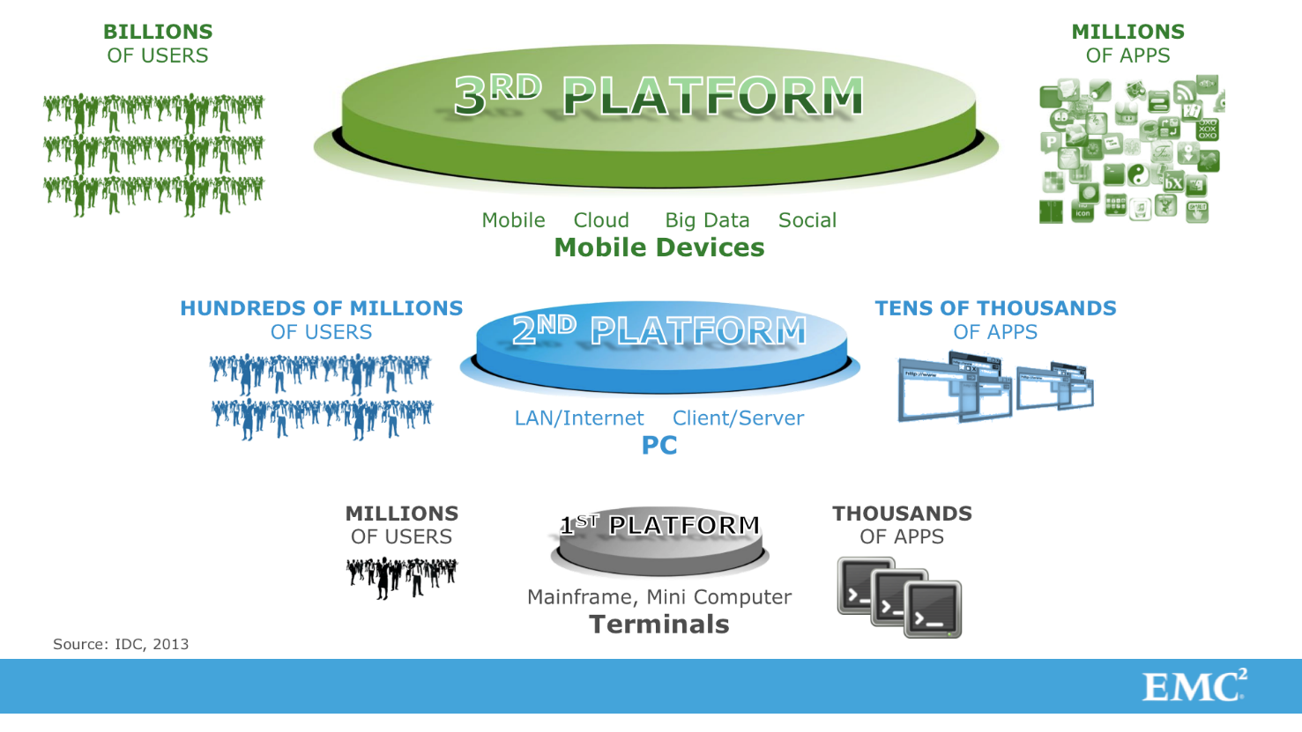
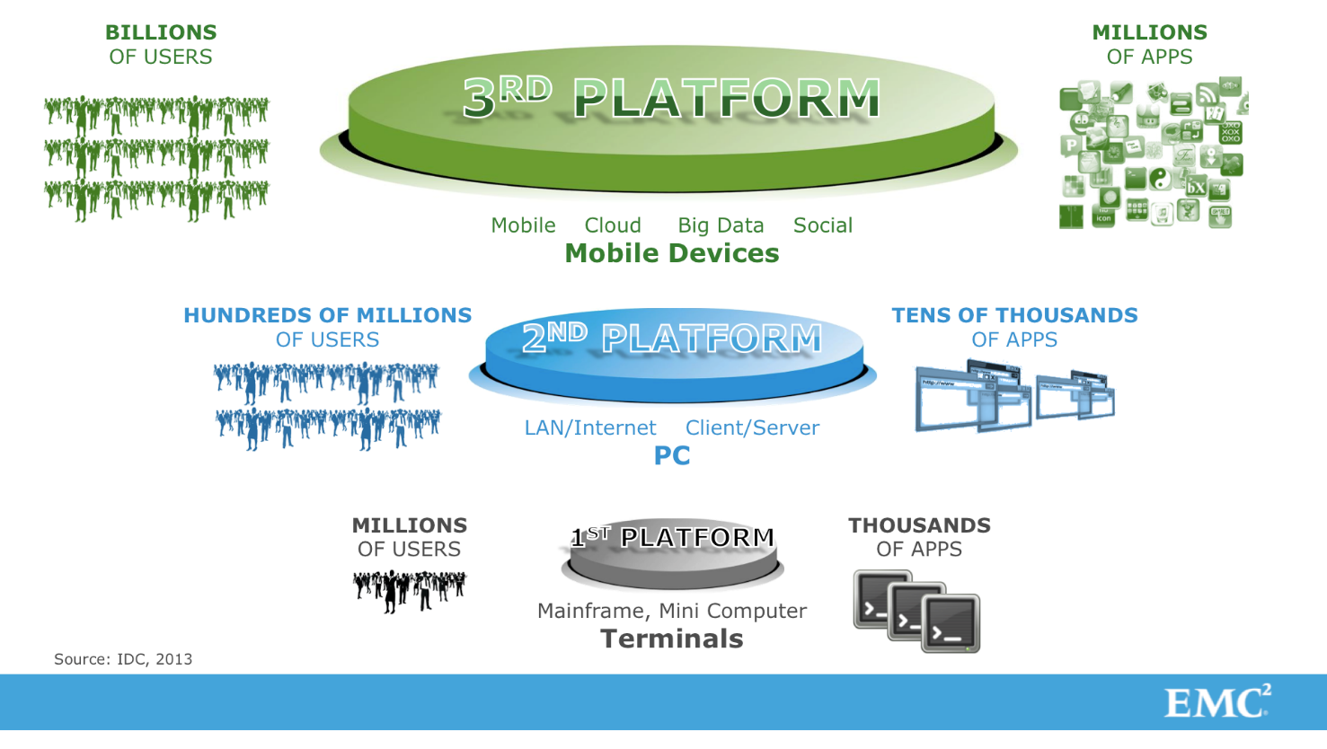
Why?
3rd Platform drives new demands on the database:
Global High Availability
Data volumes
Unstructured data
Transaction rates
Latency
A single architecture cannot meet all those demands

Slide 13
It takes all sorts
Analytic/BI software (SAS, Tableau)
In-memory processing (Spark)
Web Server
Hadoop
Data Warehouse RDBMS
(Oracle, Terradata …)
In-memory Analytics (HANA, Exalytics …)
Web DBMS (MySQL, Mongo, Cassandra)
Operational RDBMS (Oracle, SQL Server, …)
ERP & in-house CRM

Slide 14
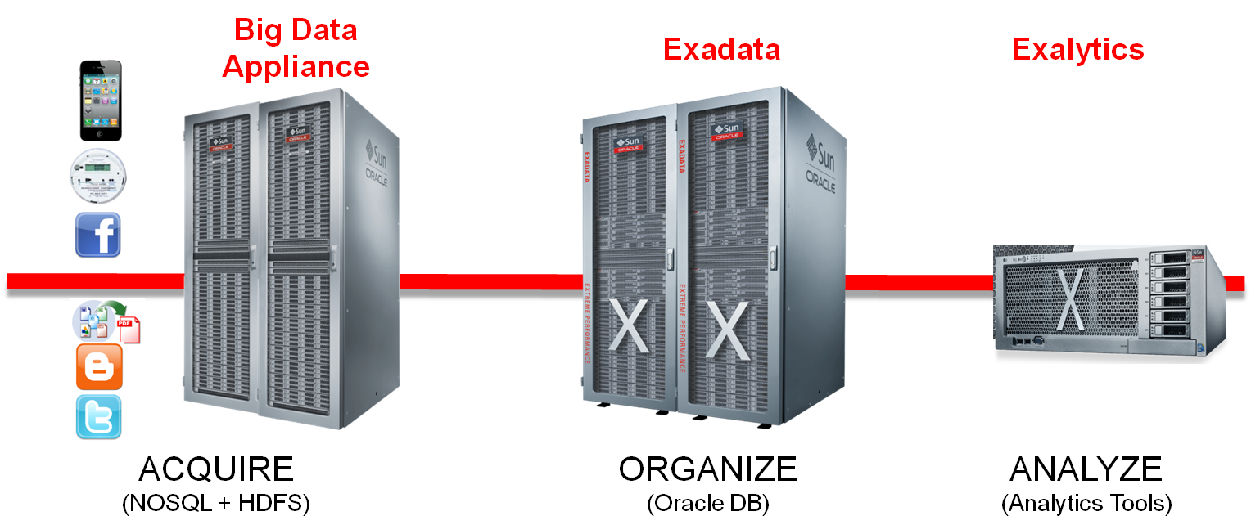
Oracle engineered systems

Slide 15
Trend #2: Big Data and Hadoop

Slide 16
The 3-4 “V”s
Volume
Velocity
Variety
Terabytes
Petabytes
Exabytes
Zetabytes
Structured
Unstructured
Human Generated
Machine Generated
Transaction rates
User populations
Machines
Value

Slide 17
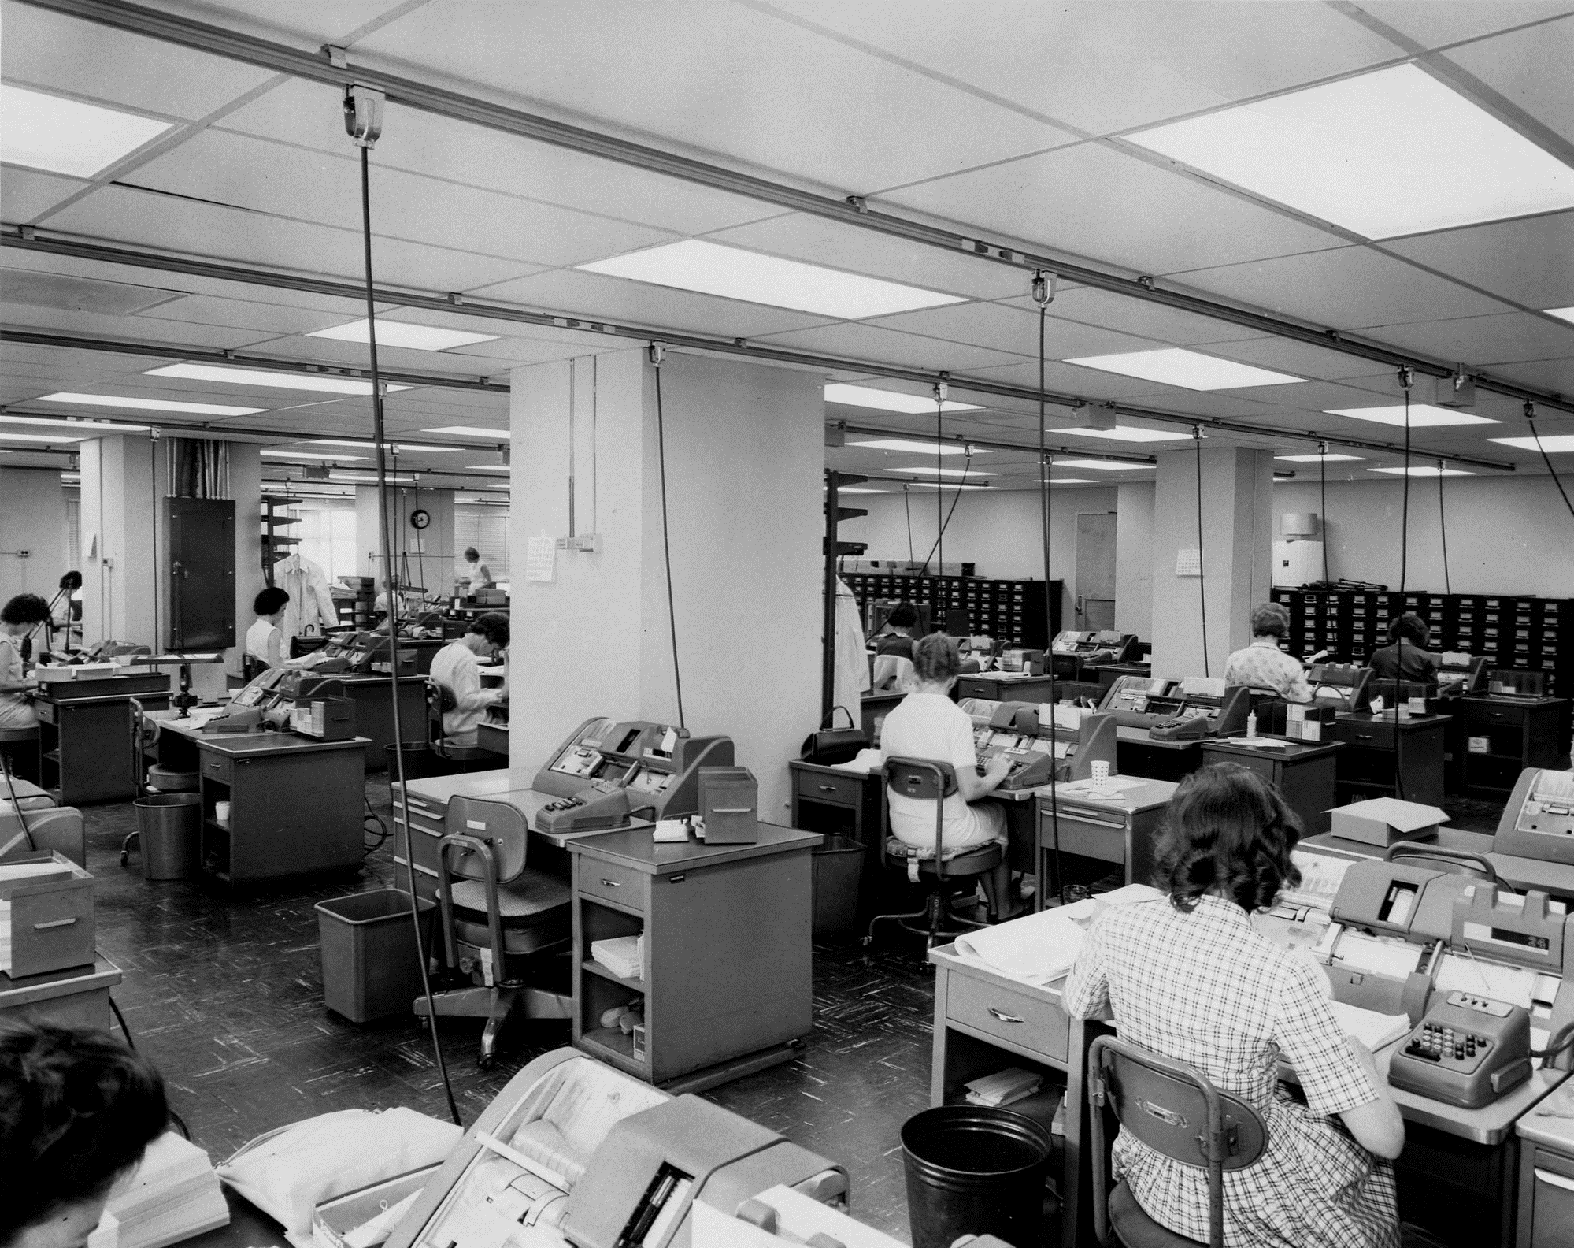
The Industrial revolution of data

Slide 18
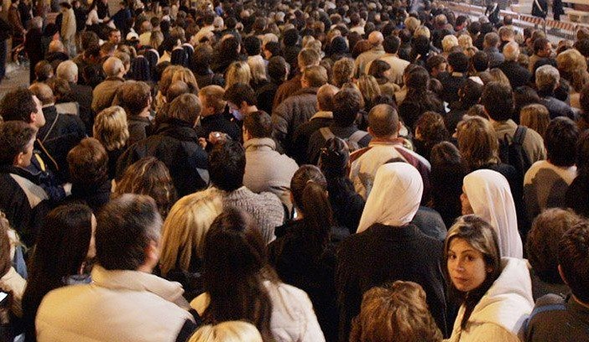
2005

Slide 19
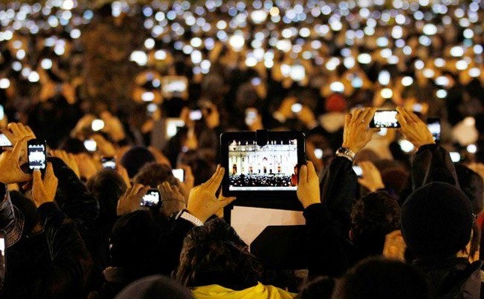
2009

Slide 20

The instrumented human
Compass
Camera
Mike/earphones
Heads up display
Emotion/Attention monitor
Bluetooth Personal Area Network
3G/WiFi Wide Area Network
GPS
Storage
Pulse, temp monitor
Silent alarms
Pedometer, sleep monitoring

Slide 21
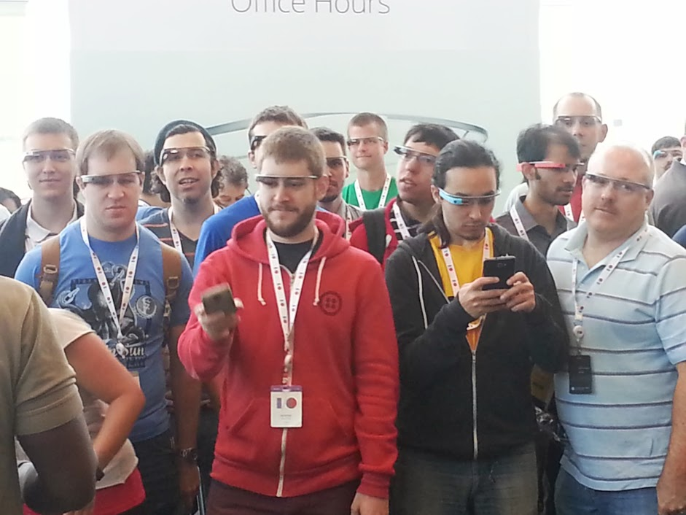
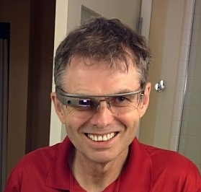
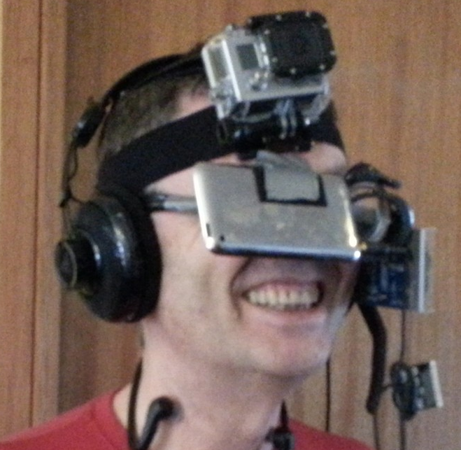

Slide 22
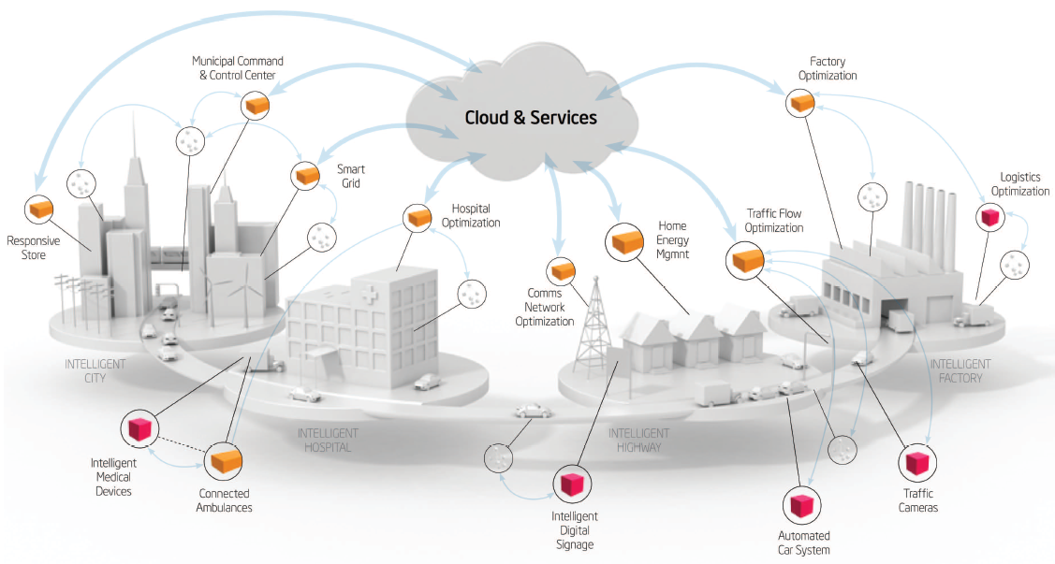
The instrumented world

Slide 23



Big Data is the culmination of cloud, social and mobile

Slide 24
More Data
To More Effect
Storing all data – including machine generated and sol, Social, community, demographic data in original format – for ever
Smarter use of data (data science) to achieve competitive or human benefit

Slide 25
More Data
To More Effect
Storing all data – including machine generated and sol, Social, community, demographic data in original format – for ever
Smarter use of data (data science) to achieve competitive or human benefit

Slide 26

Pioneers of big data

Slide 27
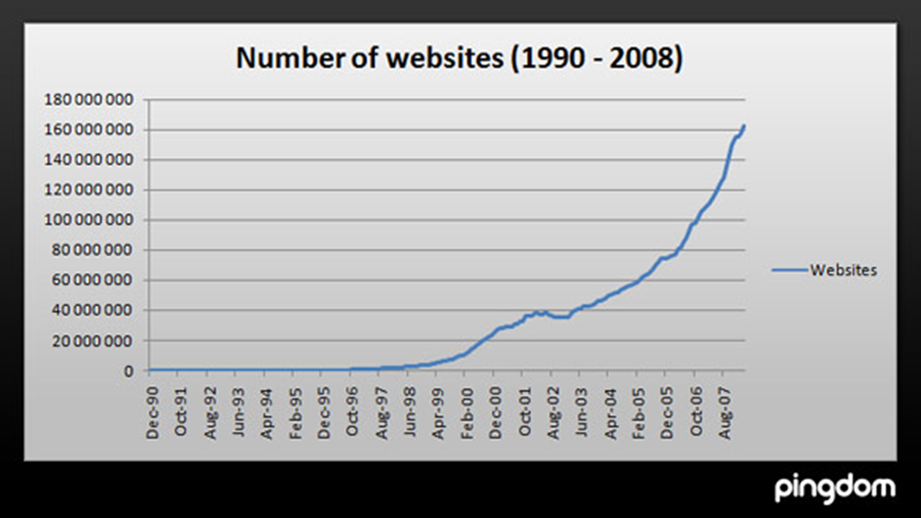

Slide 28
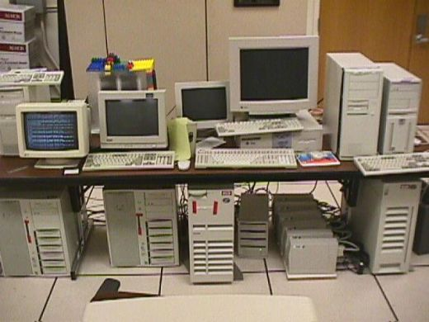
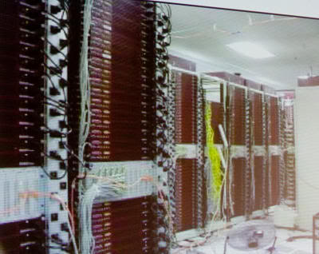

Slide 29
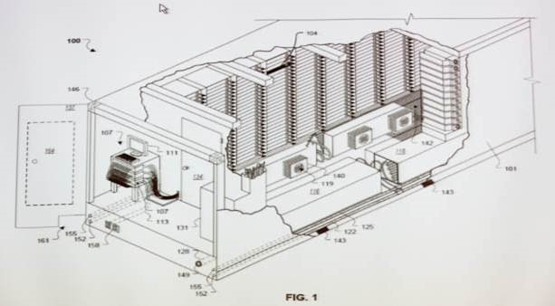

Slide 30
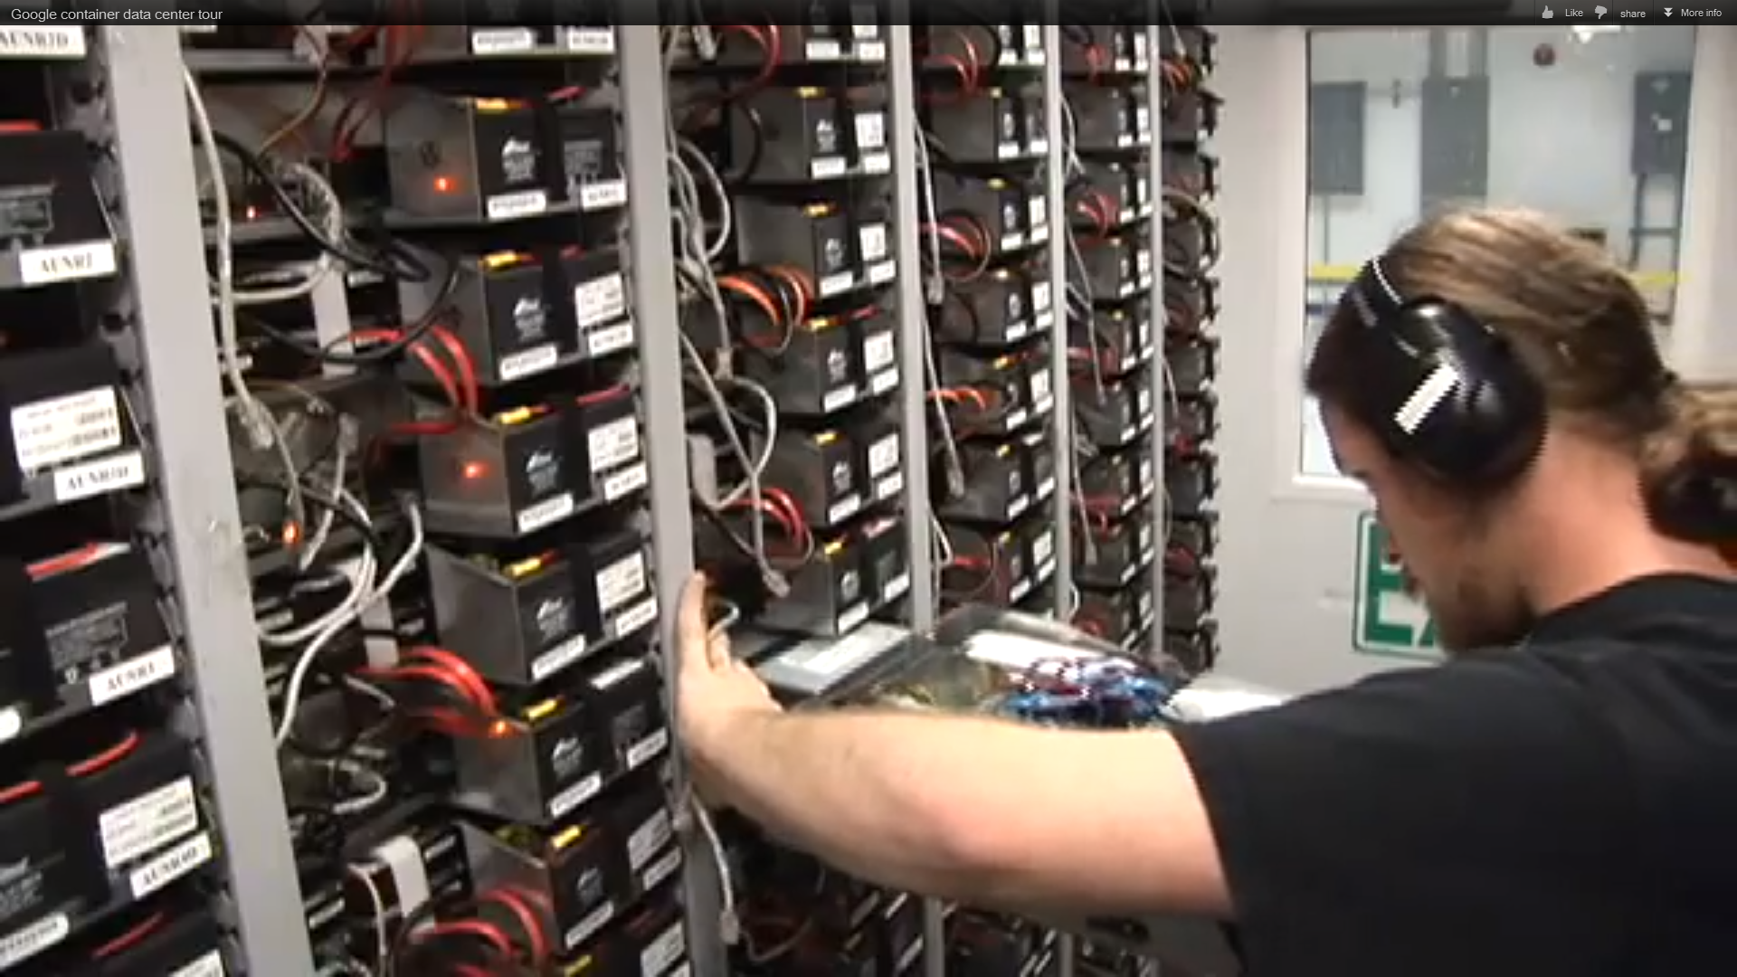

Slide 31
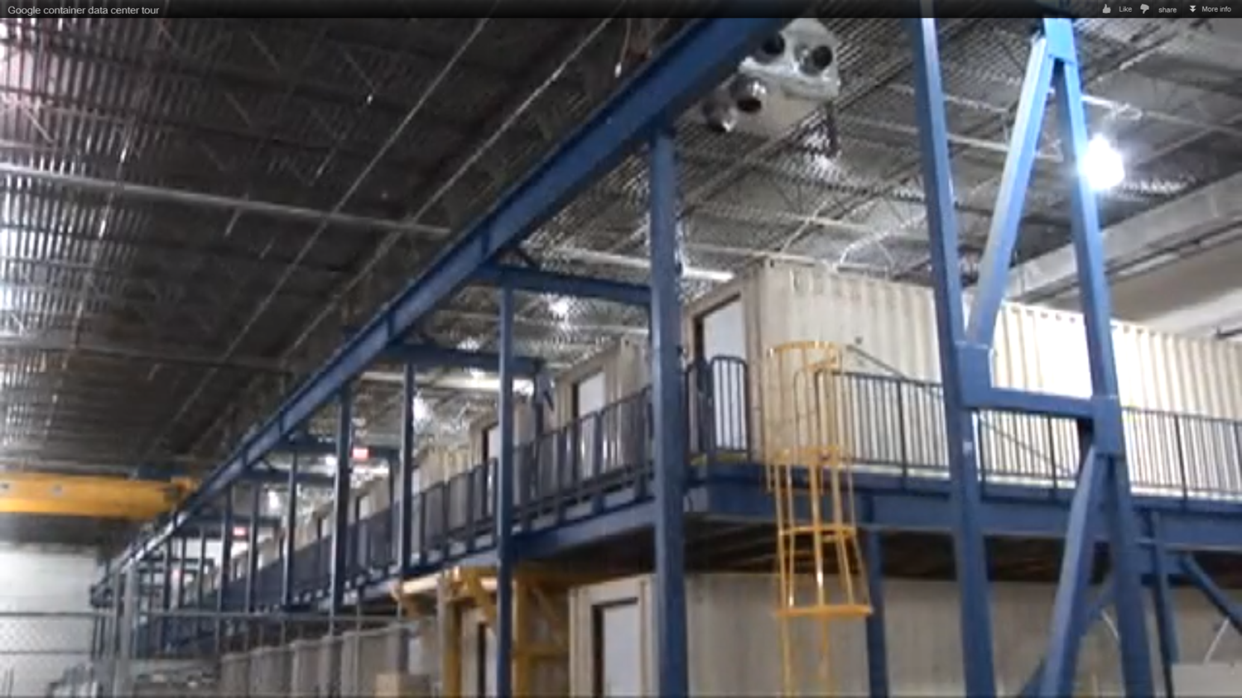

Slide 32
Google Software Architecture (circa 2005)
Google Applications
Map Reduce
BigTable
Google File System (GFS)

Slide 33
Map Reduce
Map
Map
Map
Map
Map
Map
Map
Map
Map
Map
Start
Map
Map
Reduce
Map
Map
Map
Map
Map
Map
Map
Map
Map
Map
Map
Map
Map
Map
Map
Map
Map
Map
Map
Map
Map
Map
Map

Slide 34
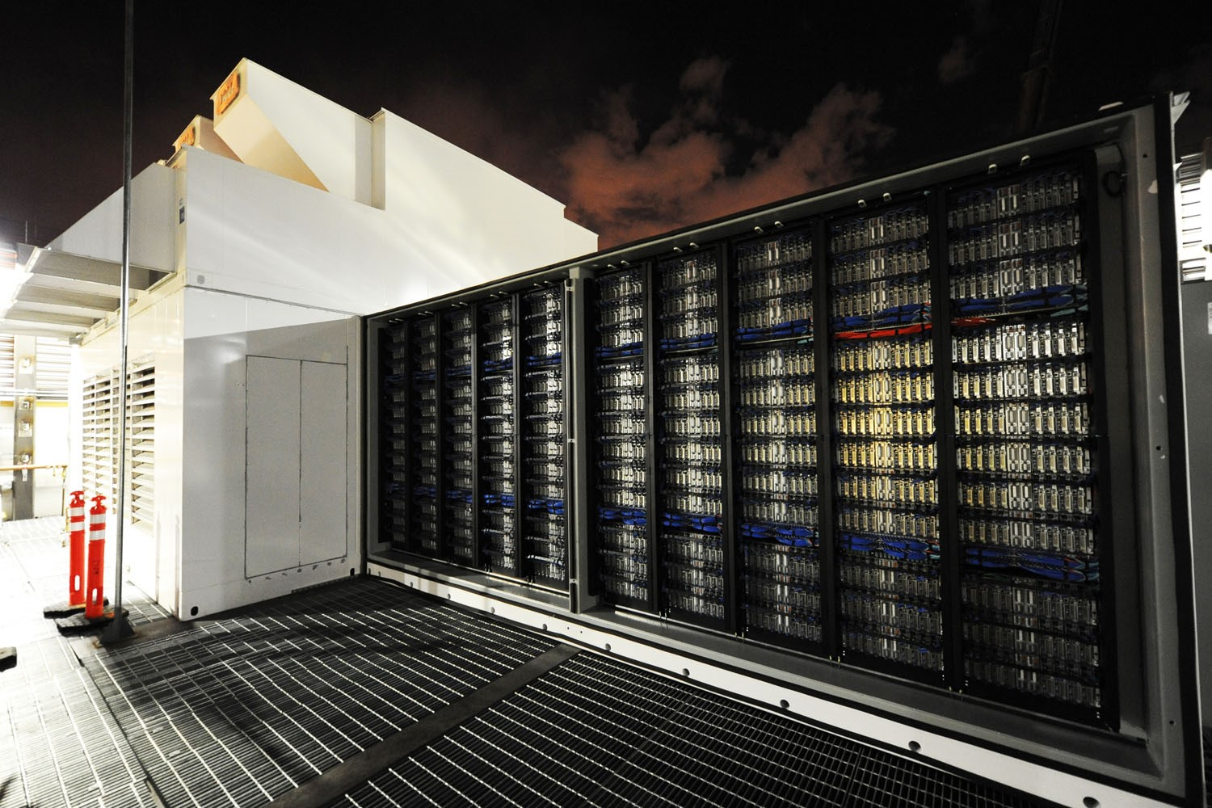
Hadoop: 1.0: Open Source Map-Reduce Stack

Slide 35
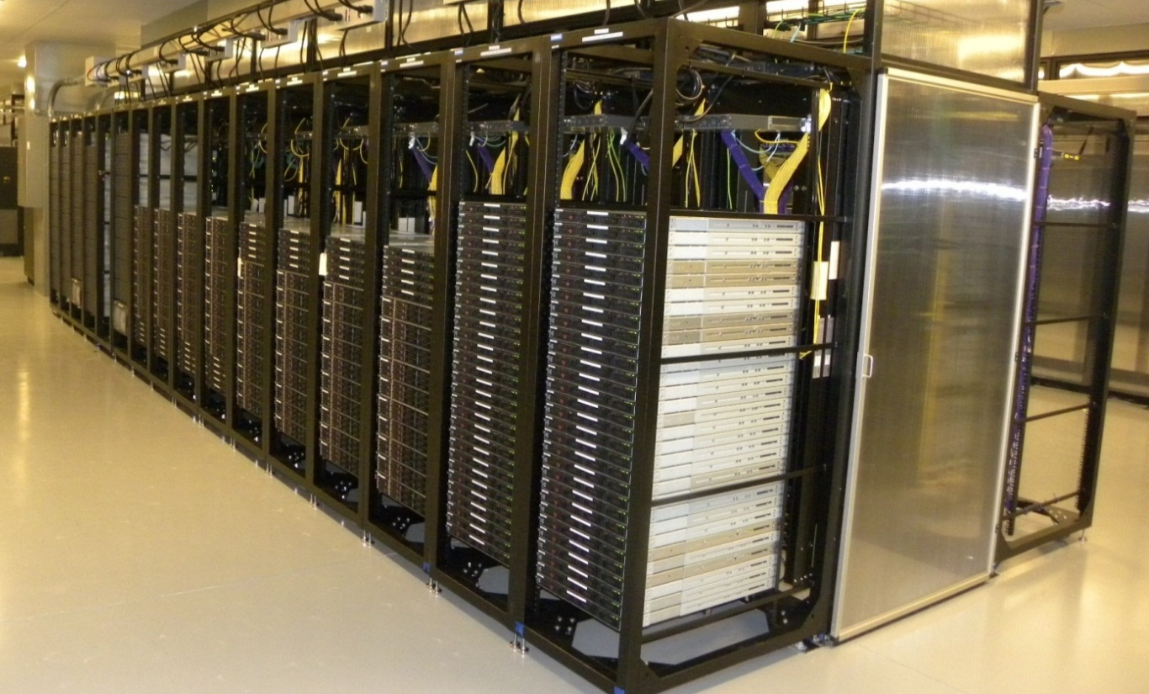
Hadoop at Yahoo
2010(biggest cluster):
4000 nodes 16PB disk
64 TB of RAM
32,000 Cores
2014:
16 Clusters
32,500 nodes

Slide 36
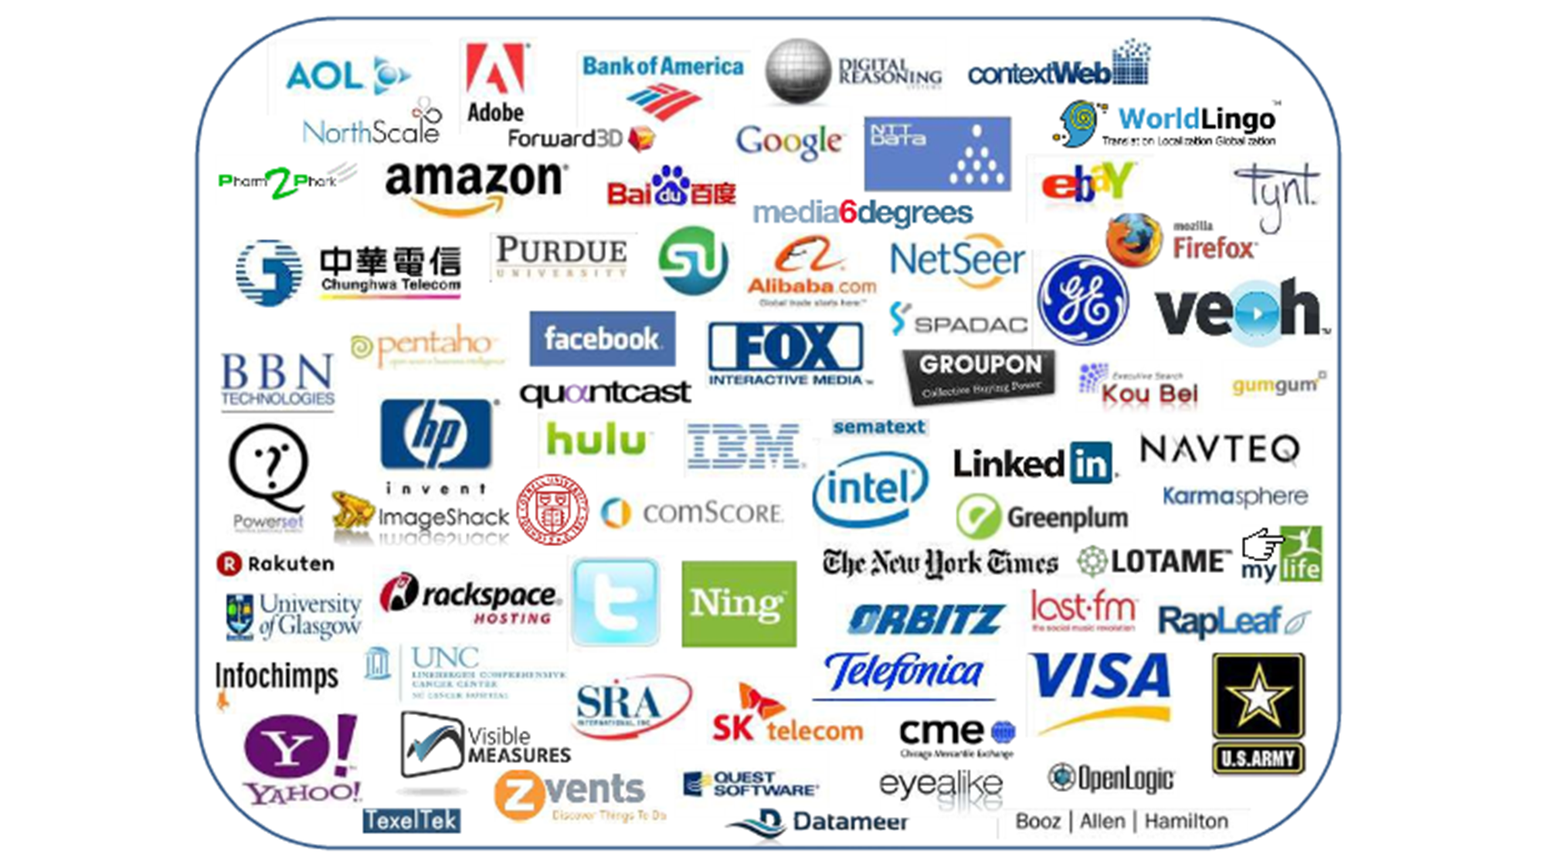

Slide 37
Hadoop family
Oozie (Workflow manager)
Hive
(Query)
Pig
(Scripting)
SQOOP
(RDBMS loader)
Flume
(Log Loader)
Map Reduce /
YARN
Hbase
(database)
Zookeeper
(locking)
Hadoop File System (HDFS)

Slide 38
Hadoop 1.0
Map reduce
Jobs
Hadoop Client (Java, Pig, Hive)
HDFS (Distributed Storage)
Job tracker
Name Node
Secondary Name Node
Data Node Task tracker
Data Node
Task tracker
Data Node
Task tracker
Data Node
Task tracker
Data Node
Task tracker
Data Node Task tracker
Data Node
Task tracker
Data Node
Task tracker
Data Node
Task tracker
Data Node
Task tracker
Data Node Task tracker
Data Node
Task tracker
Data Node
Task tracker
Data Node
Task tracker
Data Node
Task tracker

Slide 39
Economies

Slide 40
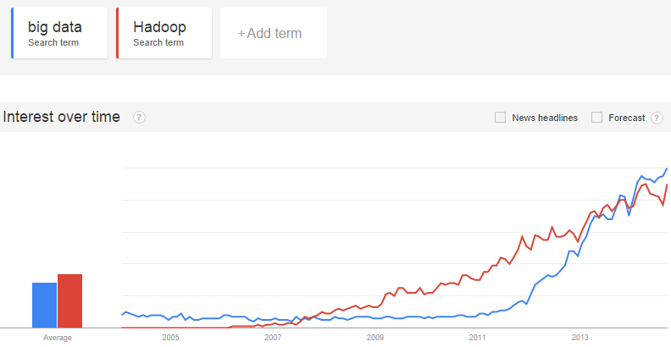
Hadoop is the most concrete Big Data technology
Toad: your companion in the Big Data revolution

Slide 41
More Data
To More Effect
Storing all data – including machine generated and sol, Social, community, demographic data in original format – for ever
Smarter use of data (data science) to achieve competitive or human benefit

Slide 42
More Data
To More Effect
Storing all data – including machine generated and sol, Social, community, demographic data in original format – for ever
Smarter use of data (data science) to achieve competitive or human benefit

Slide 43
Big Data Analytics AKA Data Science
Machine Learning
Predictive Analytics
Collective Intelligence
Programs that use inputs from “crowds” to simulate intelligence
Programs that evolve with “experience
Programs that extrapolate from past to future

Slide 44
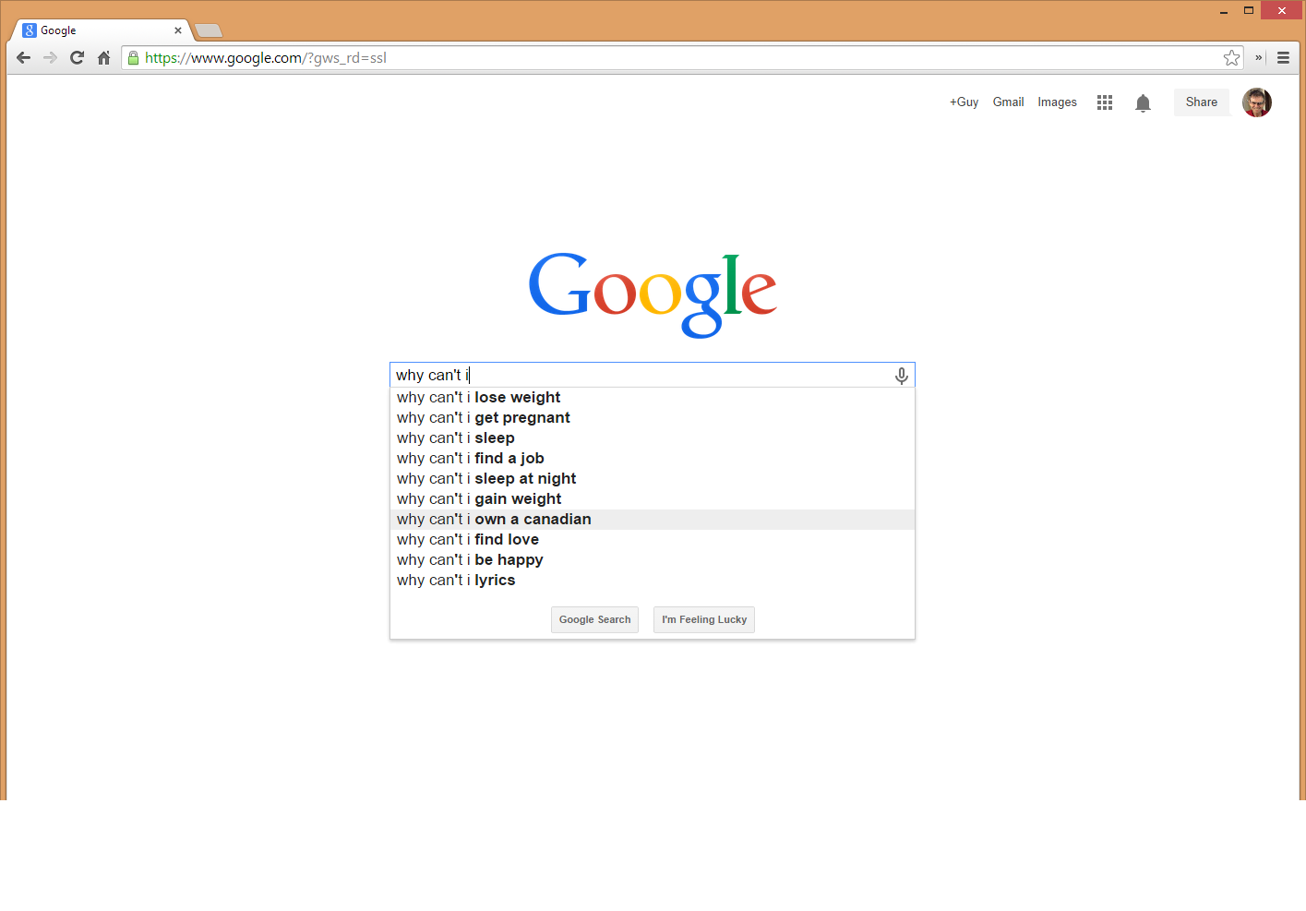
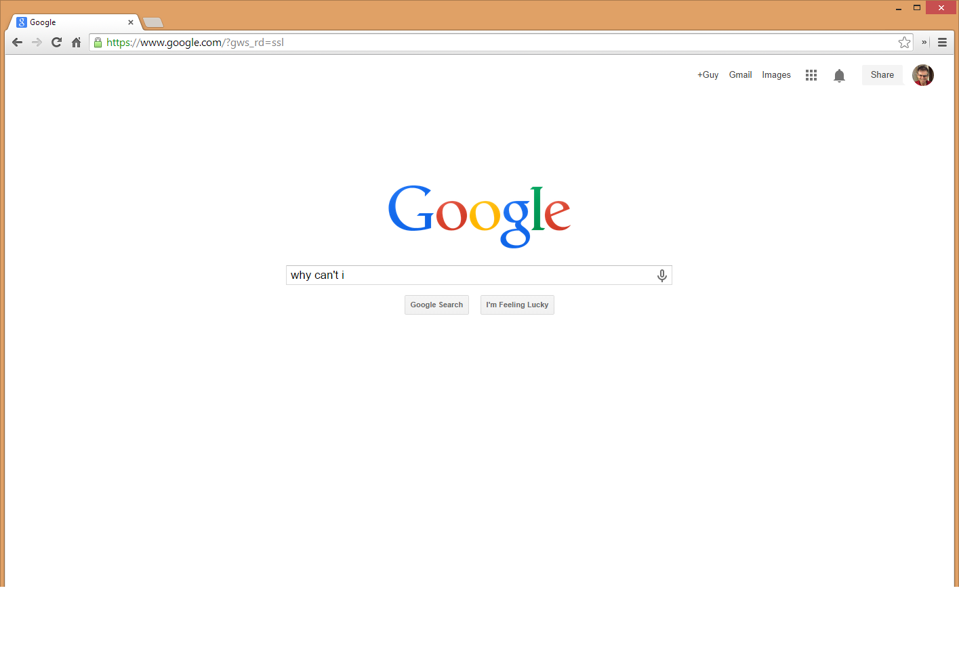

Slide 45
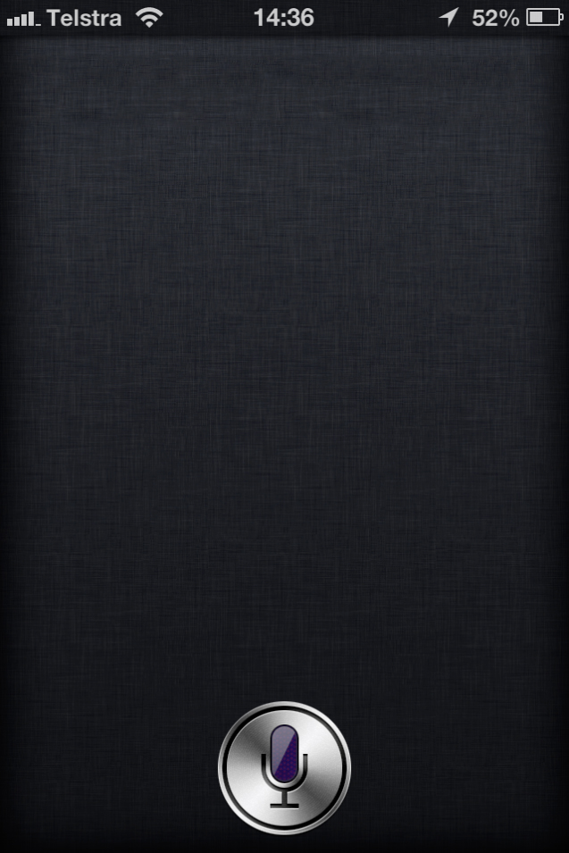
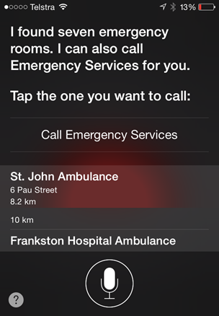

Collective Intelligence
“Siri call me an ambulance”
From now on, I’ll call you ‘An Ambulance’. OK?

Slide 46
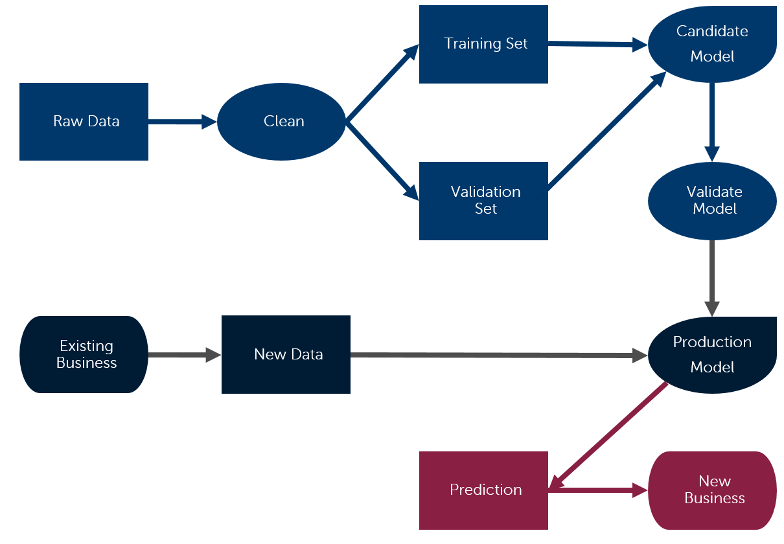
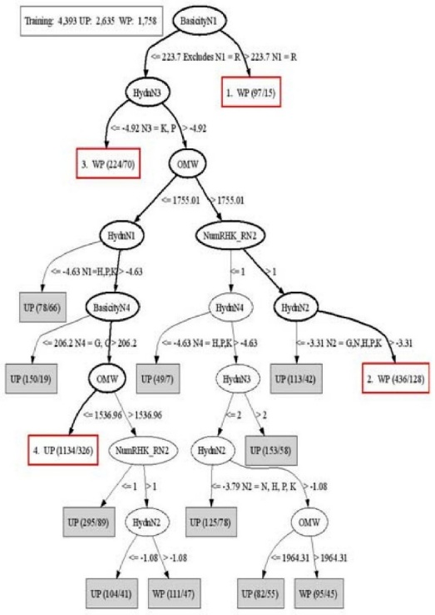
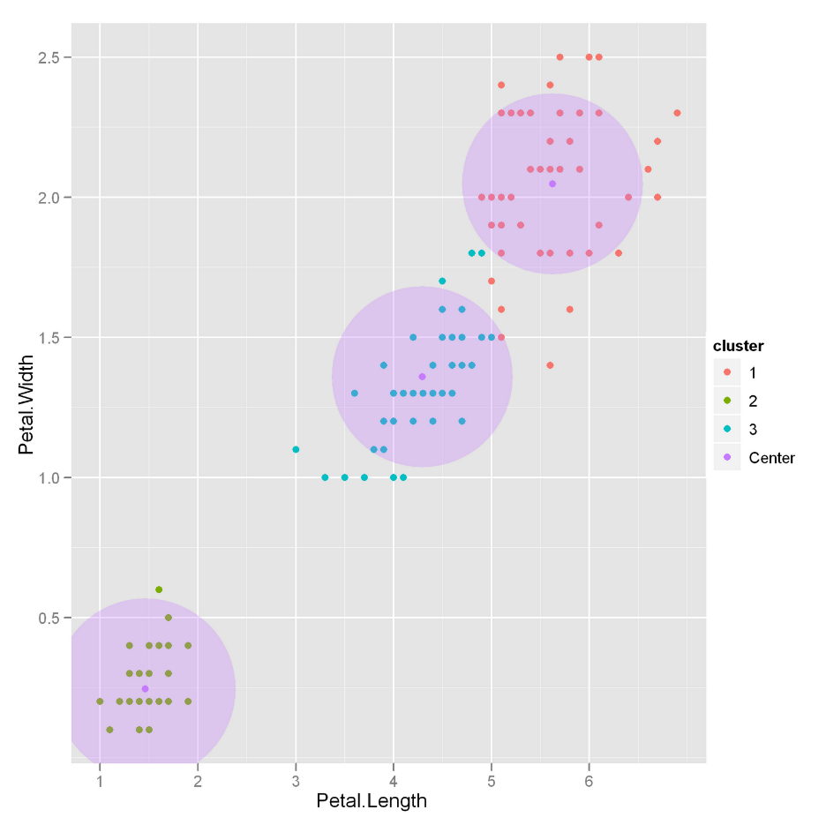
Data science
Predictive Analytics
Classification
Clustering
Model training and deployment

Slide 47
Trend #3: NoSQL

Slide 48
Web Servers
Memcached Servers
Database
Servers
Read Only Slaves
Shard (A-F)
Shard (G-O)
Shard (P-Z)

Slide 49
CAP Theorem says something has to give
CAP (Brewer’s) Theorem says you can only have two out of three of Consistency, Partition Tolerance, Availability
Consistency
Availability
System stays up when nodes fail
Partition Tolerance
Everyone always sees the same data
System stays up when network between nodes fail
Oracle RAC lives here
NO
GO
Most NoSQL lives here

Slide 50
Major influences on non-relational
Amazon Dynamo
Google BigTable
OODBMS and XML DBs
Eventually consistent transaction model
Consistent hashing
Column Family model for sparse distributed columnar data
Paved the way for the document database

Slide 51
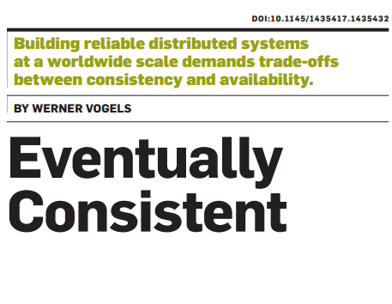
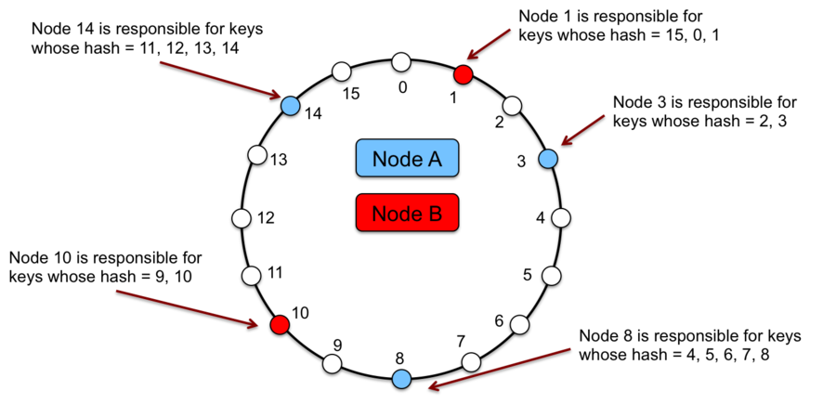
Amazon Dynamo Model

Slide 52
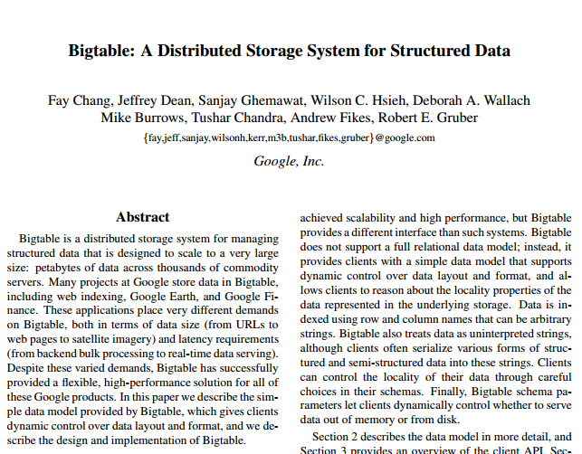
BigTable Data Model

Slide 53
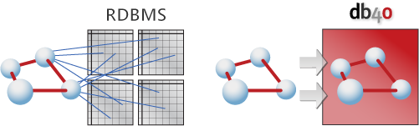
OODBMS -1990s
The OODBMS Manifesto (Atkinson/Bancilhon/DeWitt/Dittrich/Maier/Zdonik, '90)
"A relational database is like a garage that forces you to take your car apart and store the pieces in little drawers“
Also SQL is ugly
“A Object database is like a closet which requires that you hang up your suit with tie, underwear, belt socks and shoes all attached” (Dave Ensor)
http://4.bp.blogspot.com/-IPgd1Tg8ByE/UkOzH-g1FmI/AAAAAAAACB0/QYg8kEVp5_0/s1600/db4o_vs_orm.png

Slide 54
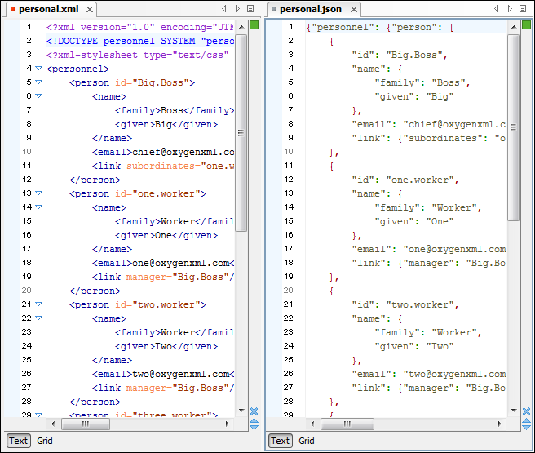
Revenge of the Object Nerds – Document databases
Structured documents – XML and JSON (JavaScript Object Notation) become more prevalent within applications
Web programmers start storing these in BLOBS in MySQL
Emergence of XML and JSON databases

Slide 55
Riak
DynamoDB
Voldemort
Dynamo
Key Value
MemchacheDB
Oracle NoSQL
XML based
RethinkDB
CouchDB
MongoDB
Document
JSON based
MarkLogic
BerkeleyDB XML
Accumulo
Hbase
Cassandra
BigTable
Table Based
HyperTable
FlockDB
Infinite Graph
Neo4J
Graph Database

Slide 56
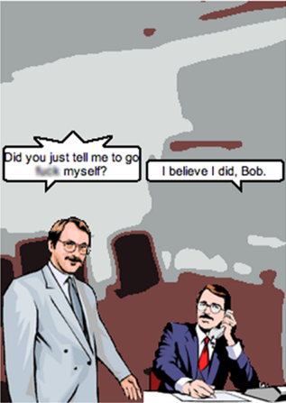
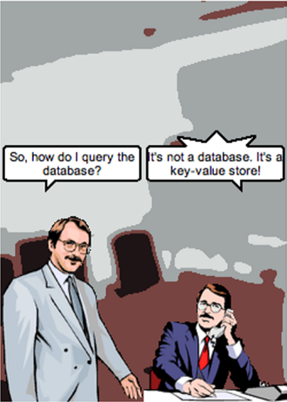
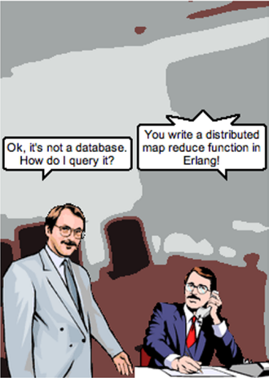
It’s not a database, it’s a key value store
http://browsertoolkit.com/fault-tolerance.png
Notes:
NoSQL tends to be strongly coupled with the application. Everybody else is out of luck

Slide 57

No Means Yes!

Slide 58
Trend #4: Column-oriented DB

Slide 59
Row orientation vs column orientation
Row oriented database
ID | Name | DOB | Salary | Sales | Expenses
1001 | Dick | 21/12/60 | 67,000 | 78980 | 3244
1002 | Jane | 12/12/55 | 55,000 | 67840 | 2333
1003 | Robert | 17/02/80 | 22,000 | 67890 | 6436
1004 | Dan | 15/03/75 | 65,200 | 98770 | 2345
1005 | Steven | 11/11/81 | 76,000 | 43240 | 3214
Block | ID | Name | DOB | Salary | Sales | Expenses
1 | 1001 | Dick | 21/12/60 | 67,000 | 78980 | 3244
2 | 1002 | Jane | 12/12/55 | 55,000 | 67840 | 2333
3 | 1003 | Robert | 17/02/80 | 22,000 | 67890 | 6436
4 | 1004 | Dan | 15/03/75 | 65,200 | 98770 | 2345
5 | 1005 | Steven | 11/11/81 | 76,000 | 43240 | 3214
Block
1 | Dick | Jane | Robert | Dan | Steven
2 | 21/12/60 | 12/12/55 | 17/02/80 | 15/03/75 | 11/11/81
3 | 67,000 | 55,000 | 22,000 | 65,200 | 76,000
4 | 78980 | 67840 | 67890 | 98770 | 43240
5 | 3244 | 2333 | 6436 | 2345 | 3214
Column oriented database

Slide 60
Analytical Queries
Row oriented database
SELECT SUM(salary) FROM saleperson
Block | ID | Name | DOB | Salary | Sales | Expenses
1 | 1001 | Dick | 21/12/60 | 67,000 | 78980 | 3244
2 | 1002 | Jane | 12/12/55 | 55,000 | 67840 | 2333
3 | 1003 | Robert | 17/02/80 | 22,000 | 67890 | 6436
4 | 1004 | Dan | 15/03/75 | 65,200 | 98770 | 2345
5 | 1005 | Steven | 11/11/81 | 76,000 | 43240 | 3214
Block
1 | Dick | Jane | Robert | Dan | Steven
2 | 21/12/60 | 12/12/55 | 17/02/80 | 15/03/75 | 11/11/81
3 | 67,000 | 55,000 | 22,000 | 65,200 | 76,000
4 | 78980 | 67840 | 67890 | 98770 | 43240
5 | 3244 | 2333 | 6436 | 2345 | 3214
Column oriented database

Slide 61
Compression
Row oriented database
Block | ID | Name | DOB | Salary | Sales | Expenses
1 | 1001 | Dick | 21/12/60 | 67,000 | 78980 | 3244
2 | 1002 | Jane | 12/12/55 | 55,000 | 67840 | 2333
3 | 1003 | Robert | 17/02/80 | 22,000 | 67890 | 6436
4 | 1004 | Dan | 15/03/75 | 65,200 | 98770 | 2345
5 | 1005 | Steven | 11/11/81 | 76,000 | 43240 | 3214
Poor compression ratio (low repetition)
Good compression ratio (high repetition)
Block
1 | Dick | Jane | Robert | Dan | Steven
2 | 21/12/60 | 12/12/55 | 17/02/80 | 15/03/75 | 11/11/81
3 | 67,000 | 55,000 | 22,000 | 65,200 | 76,000
4 | 78980 | 67840 | 67890 | 98770 | 43240
5 | 3244 | 2333 | 6436 | 2345 | 3214
Column oriented database

Slide 62
Inserts
Row oriented database
INSERT INTO salesperson
Block | ID | Name | DOB | Salary | Sales | Expenses
1 | 1001 | Dick | 21/12/60 | 67,000 | 78980 | 3244
2 | 1002 | Jane | 12/12/55 | 55,000 | 67840 | 2333
3 | 1003 | Robert | 17/02/80 | 22,000 | 67890 | 6436
4 | 1004 | Dan | 15/03/75 | 65,200 | 98770 | 2345
5 | 1005 | Steven | 11/11/81 | 76,000 | 43240 | 3214
Block
1 | Dick | Jane | Robert | Dan | Steven
2 | 21/12/60 | 12/12/55 | 17/02/80 | 15/03/75 | 11/11/81
3 | 67,000 | 55,000 | 22,000 | 65,200 | 76,000
4 | 78980 | 67840 | 67890 | 98770 | 43240
5 | 3244 | 2333 | 6436 | 2345 | 3214
Column oriented database

Slide 63
C-Store (Vertica) Solution for inserts
Read Optimized Store
Columnar
Disk-based
Highly Compressed
Bulk loadable
Bulk sequential loads
Merged
Query
Asynchronous Tuple Mover
Continual Parallel inserts
Write Optimized Store
Row oriented
Uncompressed
Single row inserts

Slide 64
Exadata Hybrid Columnar Compression (EHCC)
Compression Unit (~<1M)
Block (8K)
Block
Block
Block
Column 1
Column 2
Column 3
Column 4
Row
Row
Row

Slide 65
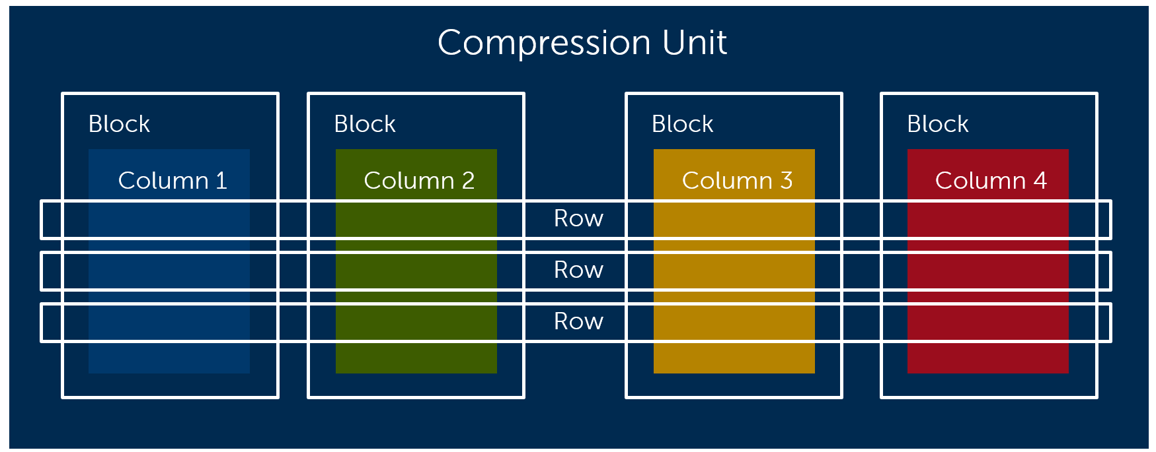
Exadata Hybrid Columnar Compression
SELECT SUM(Column4)
FROM table
Provides high compression ratio
Manageable impact on row read/write operations
Some optimization of analytic queries

Slide 66
Trend #5: The End of Disk?

Slide 67
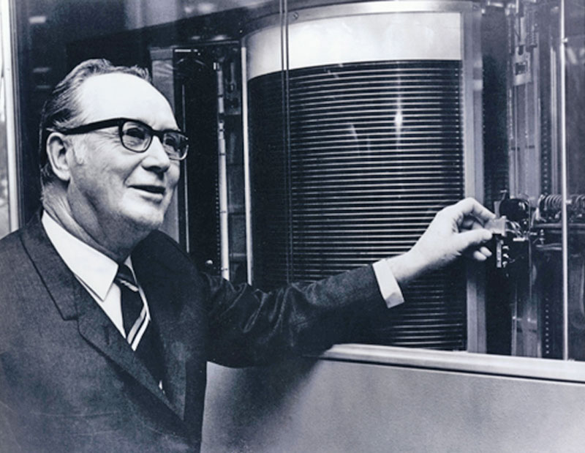
5MB HDD circa 1956

Slide 68
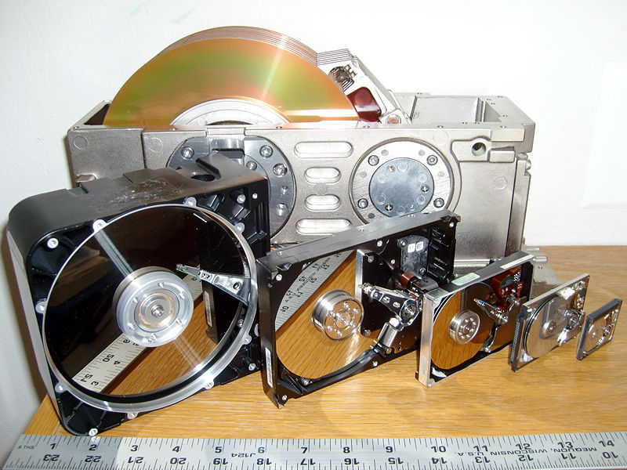
The more that things change....

Slide 69
Faster or slower?
Notes:
In 2000 a 1 TB database would have required 200 500 GB disks - with an aggregate IO capacity of around 2000 IO per second. Today that database could be supported in a single 1 TB disc but which would only support 200 I/O is per second

Slide 70
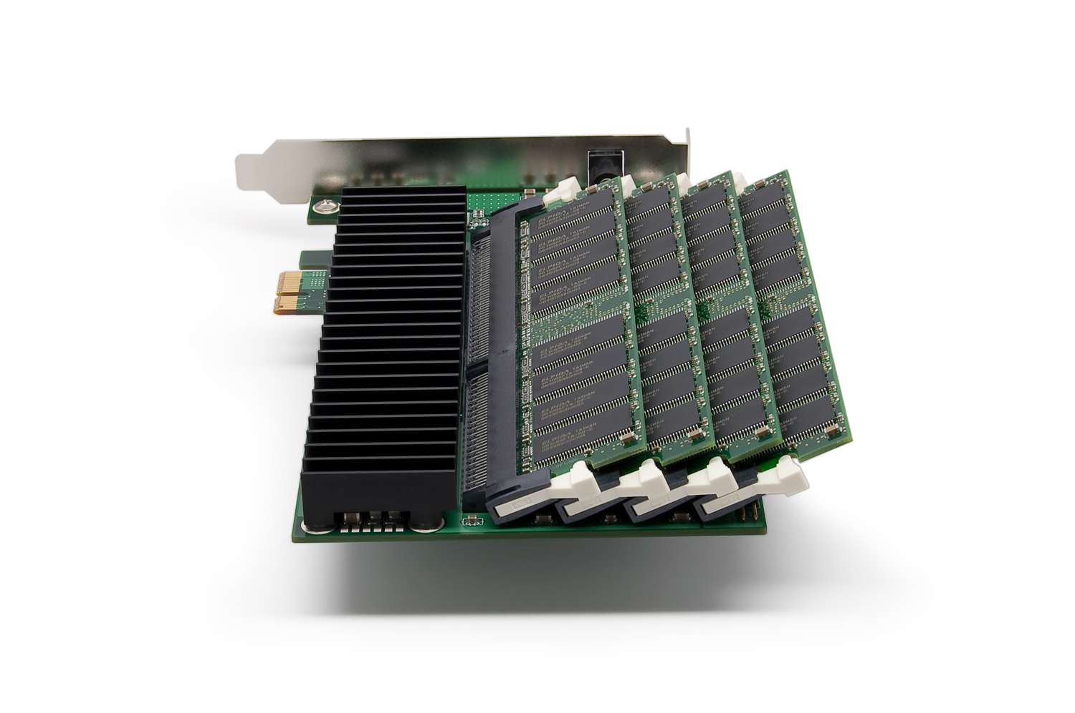



Solid state disk to the rescue
DDR RAM Drive
SATA flash drive
PCI flash drive
SSD storage Server

Slide 71
Cheaper by the IO

Slide 72
But not by the GB

Slide 73

But not by the GB
SLC SSD Cost/GB
Enterprise SSD Cost/GB
MLC SSD Cost/GB
High Performance Hard Drive Cost/GB

Slide 74
Economics of SSD
$/IOPS
$/GB

Slide 75
Database performance example
500,000 random Single block indexed reads

Slide 76
Tiered storage management
Main Memory
DDR SSD
Flash SSD
Fast Disk (SAS, RAID 0+1)
Tape, Flat Files, Hadoop
Slow Disk (SATA, RAID 5)
$/GB
$/IOP

Slide 77
In-Memory databases
Cost of RAM falling 50% each 18 months.
Some databases can fit entirely within the RAM of a single server or cluster of servers

Slide 78
Oracle Times Ten
In-memory transactional database
Disk-based Checkpoints and disk-based logging
By default, COMMITs are not durable (writes to the transaction log are asynchronous).
Can configure synchronous replication or synchronous log writes to avoid data loss
Columnar compression and analytic functions in the Exalytics version
Clients
Memory
Point in time snapshot
Checkpoints
Commits
Transaction Logs

Slide 79
SAP Hana
Memory
Persistence Layer
Column store
Txn logs
Row Store
Savepoints
Data files
Delta store
Note: Table must be either row or column – not both

Slide 80

Exalytics
Instantaneous!

Slide 81

You keep using that word….
I do not think it means what you think it means
Inigo Montoya

Slide 82

Exalytics
Software:
Oracle BI
ESSBase
Oracle R
Times-Ten
12c In-memory
Hardware:
2 TB RAM
4 10GBe , 2 InfiniBand ports
6x1.2TB SAS (7.2 TB)
3x800GB (2.4TB) SSD

Slide 83
VoltDB
Single threaded access to memory: no latch/mutex waits
Transactions in self-contained stored procedures: minimal locking
K-Safety for COMMIT: No sync waits
Clients
Clients
Clients
CPU
CPU
CPU
CPU
CPU
CPU
In-memory Partition
In-memory Partition
In-memory Partition
In-memory Partition
In-memory Partition
In-memory Partition

Slide 84
Spark (sort of) in-memory Hadoop
Berkeley Data Analytic Stack (BDAS)
In Memory compute
HDFS compatible
Libraries for data processing, machine learning, streaming, SQL, etc
Python and Scala interfaces
Part of the Berkeley Data Analytic Stack
Integrating into all Hadoop distributions (and Cassandra)
Spark Streaming
Mlib
Machine Learning
SparkSQL
Spark: in-memory distributed compute
HDFS
Tachyon – in memory File system
Mesos Cluster manager

Slide 85
Oracle 12c in-memory
database
Column store
Memory (SGA)
Row store
Column Store (IMCU)
OLTP
Analytics
(SMU)
Redo Logs
Data files

Slide 86
What does all this mean for me?

Slide 87
Trend #6: shameless product plugs will increase over the next 120 seconds

Slide 88
Toad: your companion in the Big Data revolution

Slide 89

Dell Statistica

Slide 90

Dell In-Memory Appliances for Cloudera Enterprise
Starter Configuration
8 Node Cluster
R720- 4 Infrastructure Nodes
R720XD- 4 Data Nodes
Force10- S55
~176TB (disk raw space)
~1.5TB (raw memory)
Mid-Size Configuration
16 Node Cluster
R720- 4 Infrastructure Nodes
R720XD- 12 Data Nodes
Force10- S4810P
Force10- S55
~528TB (disk raw space)
~4.5 TB (raw memory)
Small Enterprise Configuration
24 Node Cluster
R720- 4 Infrastructure Nodes
R720XD- 20 Data Nodes
~880TB (disk raw space)
~7.5 TB (raw memory)
Expansion Unit- R720XD-4 Data, Cloudera Enterprise Data Hub, Scale in Blocks

Slide 91

Dell appliances for any database
Dell provides appliances and reference architectures specifically designed for:
Oracle
SQL Server
HANA
SSD database acceleration
Large memory footprints

Slide 92
Big Data for the rest of us
Advanced Analytics
Statistica
Toad Data point
Business Intelligence
Success in Big Data requires capabilities at multiple technology levels: hardware, software infrastructure, business intelligence and analytics
Only Dell can deliver capabilities at every technology layer
Only Dell’s solutions are designed and priced to suit mid-market initial deployments and to scale to the largest enterprise
Data Integration
Boomi,
Toad Intelligence Central
Systems Management
Dell Foglight and TOAD
Boomi
Hadoop and database software
Dell appliances for Hadoop, Oracle, etc
Server and Storage
Dell servers and storage arrays

Slide 93
Thank you.

Slide 94
Please complete the session evaluation We appreciate your feedback and insight
You may complete the session evaluation either on paper or online via the mobile app

